Slide 1
Application of Neural Networks for Control of Self Balancing Bicycle
Pushkar Hiray (SC16B099)
Neelabh Dev (SC16B094)

Slide 2
Contents
Introduction
Dataset generation
Neural network training and testing.
Results

Slide 3
Introduction

Slide 4
The objective of this project is to balance an autonomous bicycle which is analogous to an inverted pendulum model using neural networks. [1]
Our problem statement is unique because we aim towards keeping the bicycle in an upright position continuously in continuous time. It is interesting because of the rise in use and need of autonomous vehicles.
We have generated our own data set using LQR controller and used it to train a feed forward neural network controller.

Slide 5
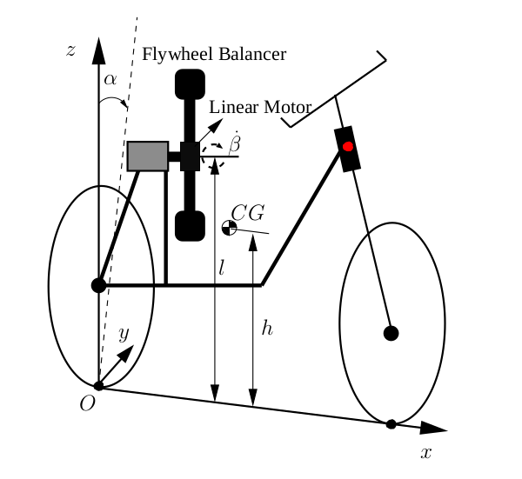
All the bicycle parameters necessary for our simulations were derived from the research paper [3]. For example:-
Bicycle mass
Height of bicycle COM
MOI of bicycle at COM
Balancer mass
MOI of balancer at COM
A state space model of the plant dynamics was made. Four states are defined according to the multi-body dynamics:
Alpha : Roll angle of the bicycle
Beta : Balancer angle
Alpha’ : rate of change of alpha
Beta’ : rate of change of beta

Slide 6
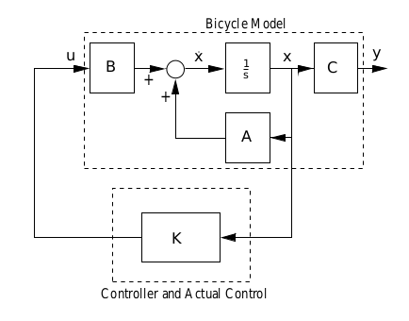
3. The input to the plant dynamics is the torque given to the balancer, while the four states can be observed from the plant dynamics.
4. Therefore, the controller has to provide the necessary torque to the plant, and since it is closed loop control, the state information is fed as input to the controller.

Slide 7
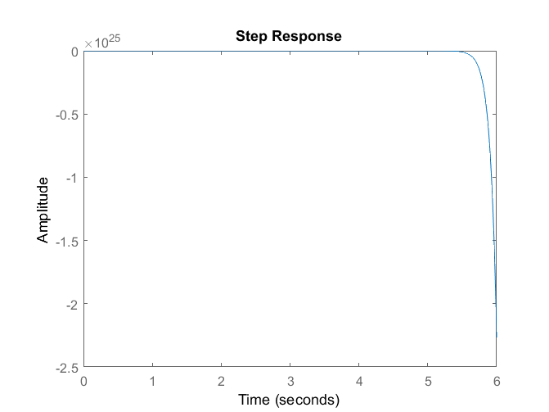
5. We used the state space technique to generate an uncompensated model of the system using our bicycle parameters.
6. The system was found to be unstable since it behaves like an inverted pendulum in unstable equilibrium.
Response of alpha wrt time for uncompensated system

Slide 8
Generating dataset

Slide 9
3. We used LQR algorithm to make a controller to keep the bicycle in an upright position.
The Linear Quadratic Regulator (LQR) is a method to optimally controlled feedback gains to enable the closed-loop stability.
It is a methodology based on the calculation of variations.
It has an infinite gain margin.
4. We have thought of LQR as a neural network without any hidden layers with ‘x’ as 4🗙1 input and ‘u’ as 1🗙1 output to find ‘K’ matrix (1🗙4) by minimizing the error.

Slide 10
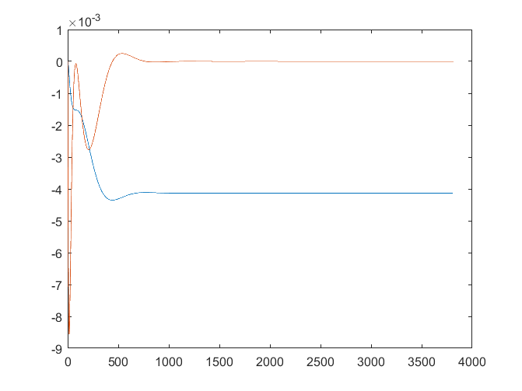
alpha and alpha_dot with time

Slide 11
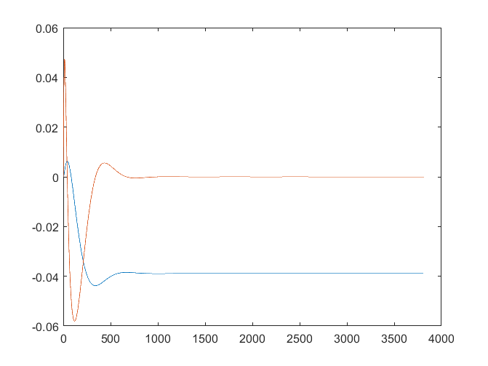
beta and beta_dot with time

Slide 12
4. We sampled the transient response at 950 samples per second to generate alpha, alpha_dot, beta, beta_dot and computed the torque output for the training dataset.
5. Torque output is taken as labels for our neural network.
6. Random values from these samples are used to generate the testing data.
7. We have a total of 3812 samples.

Slide 13
Training the Neural Network

Slide 14
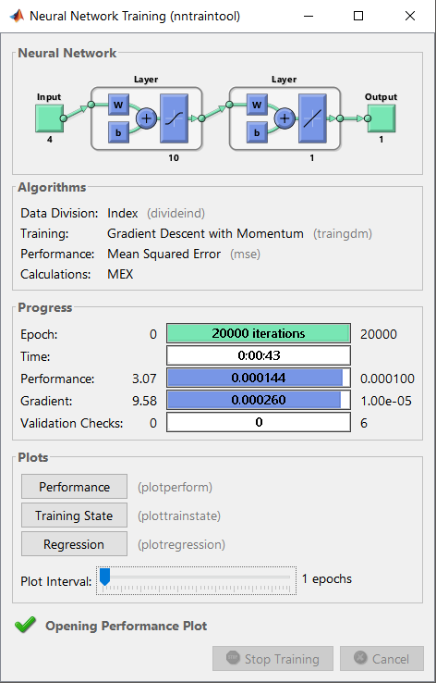
We have used the Matlab Neural network toolbox, for our simulations.
We have a feed forward neural network which has 4 input neurons and 1 output neuron.
Unlike the standard controllers for state space where there are no hidden layers, we have used a one hidden layer containing 10 neurons.

Slide 15
Since the dataset +ve as well as -ve real values, we have used a pure linear activation function for the output and tan-sigmoid activation function as a nonlinearity for the input to hidden layer.
From the total of 3812 samples generated, we have used:
Random 3000 samples for training dataset.
Remaining 812 samples for testing dataset.

Slide 16
Number of Hidden layers | 1
Neurons in a hidden layer | 10
Optimization Technique | Gradient Descent with momentum
Learning Rate | 0.05
Number of Epochs | 20000
Loss Function | Mean squared error
Activation Function (Hidden Layer) | Tansigmoid
Activation Function (Output Layer) | Linear

Slide 17
Results and Conclusions

Slide 18
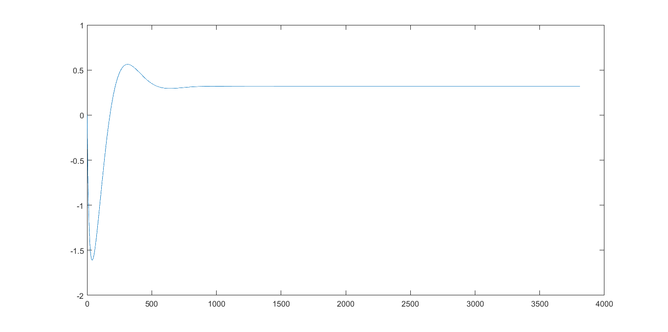
Torque Outputs without neural network controller

Slide 19
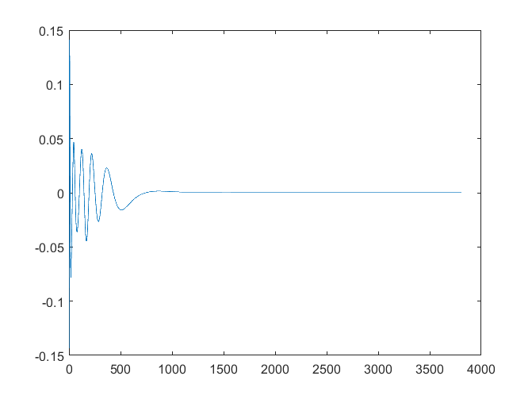
Error vs Time for NN controller

Slide 20
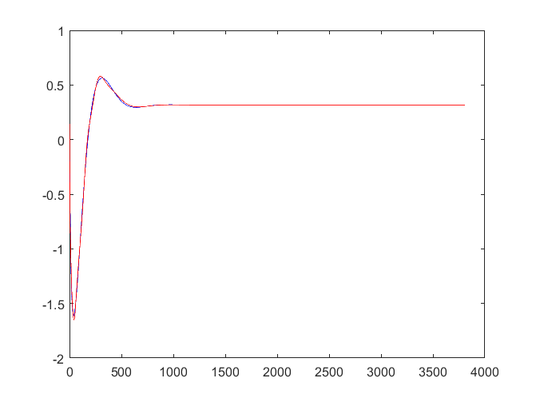
Comparison of Torque values for NN and LQR controller

Slide 21
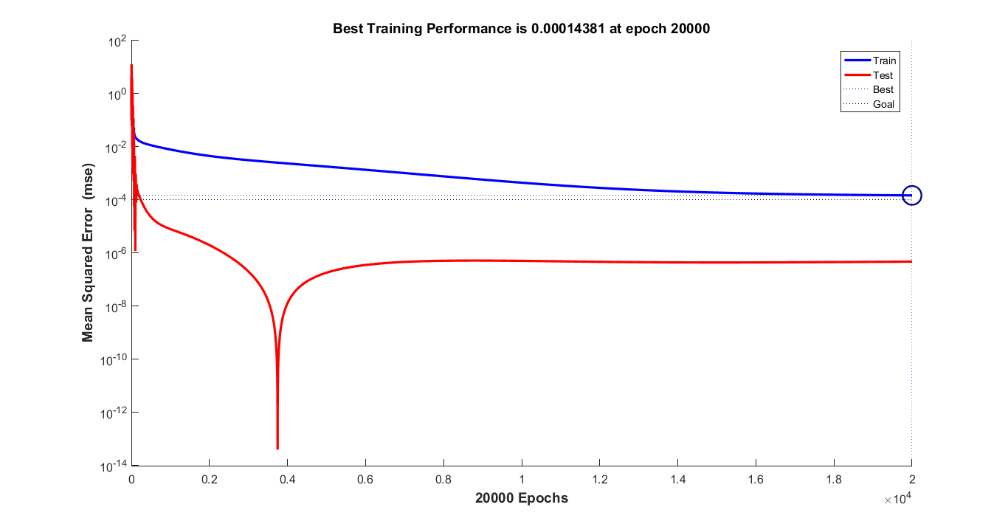
Performance Index vs Epochs

Slide 22
Final training error = 10e-5
Final testing loss = 10e-6
We used different optimization techniques in our code.
We tried simple gradient descent, gradient descent with momentum and LM.
We found out that Levenberg-Marquardt(LM) worked best for our network.

Slide 23
REFERENCES
Mladenov, Valeri. (2011). “ Application of neural networks for control of inverted pendulum.” WSEAS Transactions on Circuits and Systems. 8 .
2. Luo, Biao & Liu, Derong & Huang, Tingwen. (2014). “Q-learning for Optimal Control of Continuous-time Systems.”
3. L. Keo & M. Yamakita “Dynamic Model of a Bicycle with a balancer and its control.”

Slide 24
THANK YOU !!

